Slide 1
OS Security: Access Control

Slide 2
OS Security
Isolation between user process and kernel process
Isolation between user processes
Protection of kernel objects against
Unauthorized access
Inadvertent modification
Prevention of unauthorized access
Authentication of users
Authentication of processes

Slide 3
User Authentication

Slide 4
Authentication Measures
Something the individual knows
password, personal identification number (PIN), secret answers
Something the individual possesses (token)
keys, smart cards, fob, RFID badge
Something the individual has
Physiological biometrics (static): face, fingerprint, iris, retinal scan
Behavioural biometrics – speech, handwriting, keyboard dynamics, gait

Slide 5
Passwords
Alphanumeric strings selected by user
Not stored in cleartext for security reasons
OS stores hash of the password
Challenges:
User may not select strong password. Most users tend to select passwords that can be memorized easily.
Susceptible to dictionary attacks
Prone to rainbow attacks: malicious user creates a list of pre-computed hash of passwords

Slide 6
Hardening Passwords
Enforcing hard passwords
Long passwords
Password should contain a minimum number of special characters, numerals etc.
Change of passwords at specific intervals
Using salts
Salts are pseudorandom sequence of bits, generated by OS
Added to password before computing and storing hash
Ensures that stored hash is different for two users who happen to use same password
User can use same password on different systems
Increases complexity of attacks

Slide 7
Password with Salt
 |  | Password File
Login ID |  | Login ID | Salt | Hash Code
 |  |  |  |  |  | Salt |  |  | Password
 |  |  |  |  |  |  |  | Hash Function
 |  |  |  |  |  | Hashed password
 |  |  |  |  |  |  |  | Compare

Slide 8
Tokens
Possession based
Challenges
Authenticates whosoever possesses the token
Physical keys can be duplicated/lost/damaged
Memory card requires special reader and additional security control such as PIN
Smart chip card – cryptographic processor; difficult to duplicate

Slide 9
Physiological Biometrics
Biometric characteristics inherited at birth
Examples: Face, fingerprint, iris/retinal scans, hand geometry
Requires input acquisition; algorithmic computations for verification
Challenges
Technical deployment; Complexity
Access Time
User acceptability
Privacy issues
False positives; False negatives

Slide 10
Behavioural Biometrics
Biometric characteristics acquired
Examples: Speech, handwriting, gait, keyboard dynamics (typing rythym)
Pattern may change
affected by emotional state
sickness

Slide 11
Two Factor Authentication
Two layers of security: User needs to pass security checks for both layers before being granted access
For additional security, two different channels used for these security checks
Used in payment gateway authentication
Password and (PIN sent on registered email or through SMS on registered mobile)
Password and specific numbers corresponding to characters on grid printed on debit card

Slide 12
Access Control

Slide 13
Access Control
A security policy that specifies what type of access allowed to a subject on a given object and under what conditions
Implementation requires creation of an authorization database
Recording type of access allowed to an user for resource(s)
the access control function verifies against this database before granting access
A log maintained of all user accesses to resources (checked for unauthorized access and identification of bugs in policy and/or implementation)

Slide 14
Security Policy
Principle of Least Privilege
Principle of Attenuation of Privilege: a process can never increase its rights, or transfer rights it does not have.

Slide 15
Terminology
Subjects: An entity capable of accessing objects.
user or application actually gains access
Objects: Any resource to which access is required by user/process
Applications, firewall, routers, file, databases, disk blocks, memory segments, software objects
Access right: type of access allowed to a subject on an object
read, write, execute, functions in software objects.
Domains

Slide 16
Types
Mandatory Access Control (MAC)
Access granted on comparing resource’s security label with subject’s security clearance
A subject with requisite clearance can’t grant that clearance to another subject
Used for sensitive applications such as military
Discretionary Access Control (DAC)
Access granted on subject’s identity and authorization rules
Access can be passed to another subject
Role based Access Control (RBAC):
Access granted as per authorization rules for a role assigned to a subject at that time
Effective implementation of the principle of least privilege

Slide 17
Access Rights
Processes: delete a process, stop (block), and wake up a process.
Devices: read/write the device, control its operation (e.g., a disk seek), block/unblock the device for use.
Memory locations or regions: read/write certain locations of regions of memory that are protected, read/write access not allowed.
Subjects: grant or delete access rights of that subject to other objects, as explained subsequently.

Slide 18
Access Control Matrix

Slide 19
Access Control Matrix
Rows represent users
Columns present objects
Each cell records access rights of the respective subject on the corresponding object
 | File 1 | File 2 | File 3 | Directory1
User 1 | Own R W | - | R
User 2 | R | Own R W | R | Own R X
User 3 | - | - | Own R W | R
User 4 | R W | R |  | R

Slide 20
Access Control Matrix
A is access control matrix
A[s,o] is an entry for subject s and object o
Primitive Operations
Create new subject (adding new row)
Create new object (adding new column)
Destroy subject s (delete a row)
Destroy object s (delete a column)
Enter right r into A[s,o]
Delete right r from A[s,o]
Monitor: A hardware/software mechanism that controls checks access for an object o for subject s as per A[s,o]]

Slide 21
Primitive Operations
A’ is modified Access Control Matrix
Operation | Conditions | New State | Description
Create subject s’ | s’ ∉ O | S’ = S ∪ {s’}; O’ = O ∪ {s’} A’[s’,o] = ∅, o ∈ O’ A’[s, s’] = ∅, s ∈ S’ | Add row for s’ Execute create object s’ i.e. add column for s’ A[s’, s’] = control
Create object o’ | o’ ∉ O | S’ = S; O’ = O ∪ {o’} A’[s,o] = A[s,o]; s ∈ S; o ∈ O A’[s,o’] = ∅, s ∈ S’ | Add column for o’ Add owner in A[s,o’]
Destroy subject s’ | s’ ∈ S | S’ = S - {s’}; O’ = O - {s’} A’[s,o] = A[s,o]; s ∈ S’; o ∈ O’ | Destroy object s’ Delete row s’
Destroy object o’ | o’ ∈ O o’ ∉ S | S’ = S - {s’}; O’ = O - {o’} A’[s,o] = A[s,o]; s ∈ S’; o ∈ O’ | Delete column o’
Enter r into A[s,o] | s ∈ S o ∈ O | S’ = S; O’ = O A’[s,o] = A[s,o] ∪ {r} A’[s₁,o₁] = A[s₁,o₁] (s₁, o₁) ⍯ (s,o)
Delete r from A[s,o] | s ∈ S o ∈ O | S’ = S; O’ = O A’[s,o] = A[s,o] - {r} A’[s₁,o₁] = A[s₁,o₁] (s₁, o₁) ⍯ (s,o)

Slide 22
Create Object (File)
// Process p creates file f
Command create.file(p, f)
Create object f
Enter Own into A[p, f]
Enter R into A[p, f]
Enter W into A[p, f]
end

Slide 23
Confer Read Rights to Another Subject
// Process p confers read rights on file f to process q
Command confer.read(p, q, f)
If own in A[p,f] then
Enter R into A[q, f]
endif
end

Slide 24
Revoke Read Rights from Another Subject
// Process p revokes read rights on file f from process q
Command confer.read(p, q, f)
If own in A[p,f] then
Delete R from A[q, f]
endif
End
Owner of an object can grant a right to the object it does not have. It can grant this right to itself. This allows it to revoke its W-access to an object, and later restore the right to modify the object.

Slide 25
Transfer Read Rights to Another Subject
// Process p confers read rights on file f to process q
// R* means read rights with copy allowed
//Q is granted read rights but not allowed to transfer these to any other process
Command confer.read(p, q, f)
If R* in A[p,f] then
Enter R into A[q, f]
endif
End

Slide 26
Transfer-only Read Rights to Another Subject
// Process p confers read rights on file f to process q
// R+ means transfer of read rights allowed
Command confer.read(p, q, f)
If R+ in A[p,f] then
Delete R+ from A[p, f]
Enter R+ into A[q, f]
endif
End

Slide 27
Control Access Rights of Subordinate
// control right needed
Command create.subordinate(p, q, m)
Create subject q
Create object m
Enter control into A[p, q]
Enter R into A[q, m]
Enter W into A[q, m]
Enter E into A[q, m]
End

Slide 28
Take/Revoke Access Rights of Subordinate
Command take.subordinate.read(p, q, m)
If control in A[p,q] and R in A[q,m]
Enter R in A[p, m]
Endif
End
Command revoke.subordinate.read(p, q, m)
If control in A[p,q]
Delete R in A[q, m]
Endif
End

Slide 29
Revoke revised
// control right needed
Command revoke.read(p, q, f)
If own in A[p, f] or Control in A[p,q]
delete R from A[q, f]
Endif
End

Slide 30
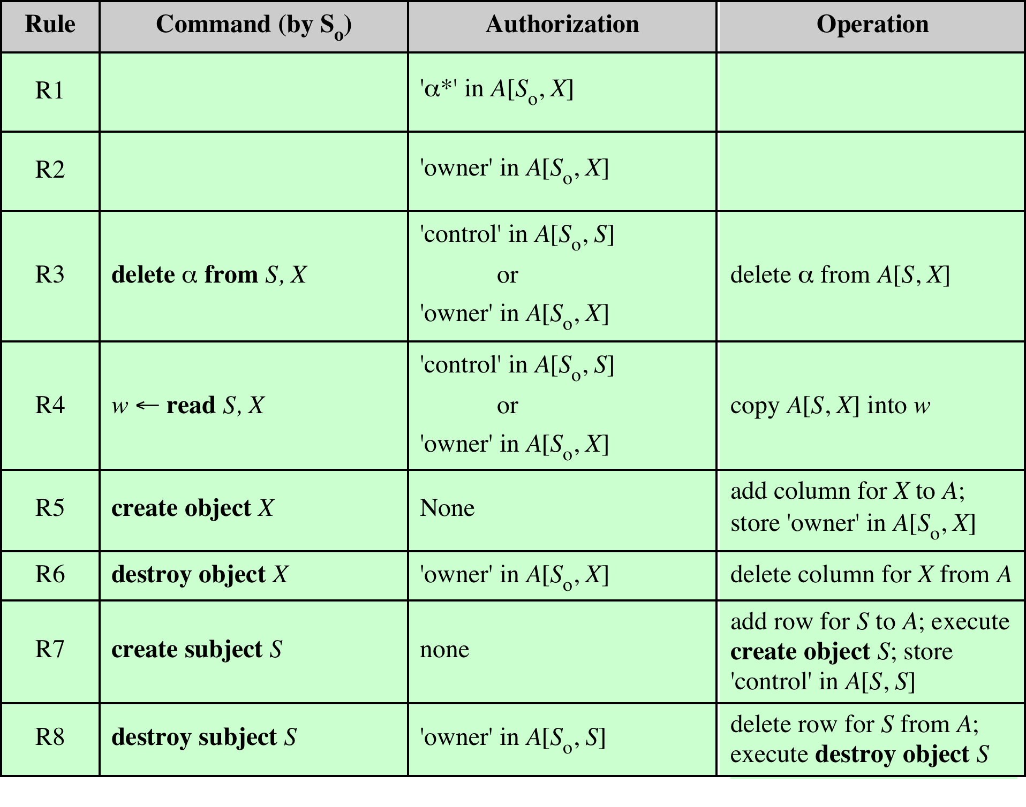
Summary

Slide 31
Protection Mechanism

Slide 32
Access Control Mechanism
S = set of all possible states
P = set of states authorized by the protection
R = set of states reachable with the security mechanisms
P and R are subsets of S
Secure: R ⊂ P; (all reachable states are authorized)
Precise: R = P (all authorized states are reachable)
Overprotective: Secure but not precise
Examples insecure systems
read file directly from disk (bypassing file system)
System not clear memory between use may expose data to unauthorized subjects.

Slide 33
Sharing
No sharing (isolation)
Sharing copies of data object
Can the subject be trusted
What if subject leaks data to others?
Sharing originals of data object
Time and space saving approach
Consistent view
Malicious modification of data?
Sharing of programs: one program calls/invokes another
share rights of execution/calling environment
Can program be trusted? Trojan horse?
Copies/leaks parameters?
Execute the program with no ability to read or copy these.

Slide 34
Confinement Problem
User connects to server for some service
Needs to pass information to server
server may leak information deemed confidential by the user

Slide 35
Principles of Protection Mechanism
Least Privilege: Grant necessary rights at a given time; execute processes in small protection domains
Economy of mechanism: simple so that can be verified
Complete Mediation: Every access should be checked for authorization
Open Design
Separation of Privilege: Access to object should depend on more than one condition being satisfied
Least Common Mechanism: Sharing should be minimal
Acceptability

Slide 36
Access Matrix Implementation

Slide 37
Access Control Matrix
Rows represent users
Columns present objects
Each cell records access rights of the respective subject on the corresponding object
 | File 1 | File 2 | File 3 | Directory1
User 1 | Own R W | - | R
User 2 | R | Own R W | R | Own R X
User 3 | - | - | Own R W | R
User 4 | R W | R |  | R

Slide 38
Access Control Matrix (contd).
Large matrix that is Sparse. Implemented as
Access Control List:
Each non-null entry in column stored as a linked list
For each object, keeps information on objects and their access rights.
Capability List:
Each non-null entry in row stored as a capability list
For each subject, keeps information on what access is permissible for which objects
Most systems keep both lists

Slide 39
Access Control Matrix
 | File 1 | File 2 | File 3 | Directory1 |  | File 1 | File 2 | File 3 | Directory1
User 1 | Own R W | - | R |  |  | User 1 Own R W | User 2 Own R W | User 3 Own R W | User 2 Own R X
User 2 | R | Own R W | R | Own R X |  | User 2 R | User 4 R | User 1 R | User 3 R
User 3 | - | - | Own R W | R |  | User 4 R |  | User 2 R | User 4 R
User 4 | R W | R |  | R |  |  | Access Control List
User 1 | File 1 O R W | File 3 R
User 2 | File 1 R | File 2 O R W | File 3 R | Directory 1 O R X |  | Capability List
User 3 | File 3 O R W | Dir 1 R
User 4 | File 1 R W | File 2 R | Dir 1 R

Slide 40
Access control mechanisms based on three concepts:
Access Hierarchies, which automatically give privileged subjects a superset of the rights of less privileged subjects.
Authorization Lists, which are lists of subjects having access rights to some particular object.
Capabilities, which are like "tickets" for objects; possession of a capability unconditionally authorizes the holder access to the object.

Slide 41
Access Hierarchy
Rings : Different levels of access allowed
Ring 0 has highest privileges
Most systems support two levels
User mode and Kernel/Supervisory mode (privileged mode)
Privileged process:: can create and destroy objects, initiate and terminate processes, access restricted regions of memory containing system tables, and execute privileged instructions
Supervisor states and ring structures are contrary to the principle of least privilege. Systems programs typically run with considerably more privilege than required.

Slide 42
Authorization List (ACL)

Slide 43
Authorization List (ACL)
An authorization list (also called an access-control list) is a list of n >= 0 subjects authorized to access some particular object x.
For object x, the k^{th} entry in the list gives the name of a subject S_{k} and the rights R_{k} in A[S_{k}, x] of the access matrix
An authorization list, therefore, represents the nonempty entries in column x of the access matrix.
Sno | Subject | Rights
1 | S1 | O R W
2 | S2 | R
3 | S3 | W
4 | S4 | R

Slide 44
ACL (contd.)
ACL implemented as two entries: first with access rights of owner and second with access rights for others.
Access rights are usually limited to R and W.
Unix employs three entries: owner; group; others
Does not meet the objective of least privilege
Search is expensive; every access not verified by OS
OS checks authorization list when a file is opened, but not for each read or write. If a right is revoked after a file is opened, the revocation takes effect only after the file is closed.
Not suitable for protecting segments of memory, where address bounds must be checked for every reference.

Slide 45
Capabilities
A capability is a pair (x, r) specifying the unique name (logical address) of an object x and a set of access rights r for x (some capabilities also specify an object’s type).
The capability is a ticket that unconditionally authorizes the holder r-access to x.
Once the capability is granted, no further validation of access is required. Without the capability mechanism, validation would be required on each access by searching an authorization list

Slide 46
Reading Assignments
Confused Deputy Problem
Clickjacking
TOCTOU (Time of Check to Time of Use) Race Condition

Slide 47
OS Security
Isolation between user process and kernel process
Isolation between user processes
Protection of kernel objects against
Unauthorized access
Inadvertent modification
Prevention of unauthorized access
Authentication of users
Authentication of processes

Slide 48
ACL : Grant and Revocation
In most systems, owner (creator) of an object can grant rights on the object to other subjects
In some systems, acquired right even on non-owned object can be granted to other users
A is owner of O1. A grants R rights on O1 to B.
B has R rights but is not owner
If B is allowed to grant rights to another subject C, what security policy be adopted?
B can only transfer rights that it has. It can’t transfer W rights.
If rights of B are revoked, rights of any subject s on O1 should be revoked only if these rights were granted through B.
Example: B is granted R rights; grants these to C which in turn grants these to D. So when B’s rights are revoked, C and D R right should also be revoked.

Slide 49
Grant/Revocation of Rights
OS needs to keep information on type of rights granted to a subject on an object. For proper implementation of revocation, it needs to keep information on grantor of rights; if grantor is owner and time when rights were granted.
Table
Graph

Slide 50
Grant/Revocation of Rights
A revokes rights of B at t =40.
B loses rights (1st row is deleted)
C loses rights granted by B (3rd row is deleted)
D loses rights granted by C(4th row is deleted)
Second row is not deleted as D, here, has been granted rights by A.

Slide 51
Grant/Revocation of Rights
A grants rights R (read), I (insert) to B at t=10, B grants these rights to C at t=15. D is granted R right by A at t = 5 and grants these rights to B at t = 20. At t=25, B grants R and I rights to C.
What if A revokes B’s rights at t=40

Slide 52
Grant/Revocation of Rights
A grants rights R (read), I (insert) to B at t=10, B grants these rights to C at t=15. D is granted R right by A at t = 5 and grants these rights to B at t = 20. At t=25, B grants R and I rights to C.
What if A revokes B’s rights at t=40

Slide 53
Grant/Revocation of Rights
What if A revokes B’s rights at t=40
Second and third rows should be deleted.
R rights of B shall be preserved as these were granted by D.
5th row is modified as I right of C was through B and not via D (indirectly)

Slide 54
Confused Deputy Problem

Slide 55
Confused Deputy
Fortran Compiler Installed in a directory say SYSX
Writes billing to a file called SYSX/BILL
Writes statistics to a file called SYSX/STATS
SYSX directory is privileged (only the compiler can write into it because it had a LISENCE file)
Usage of the Fortran compiler will look like this:
SYSX/FORT <input file> <output_file>
What happens when user issues a command
SYSX/FORT <input file> SYSX/BILL
SYSX/BILL is overwritten (why?)

Slide 56
Confused Deputy
Compiler is deputy and serving two masters
Invoker yields his authority to the compiler when he says "RUN SYSX/ FORT".
The other authority of the compiler stems from its homefiles license.
Compiler carries some authority from each to perform its respective duties. Check against which authority?
Statistics/billing: authority granted by its home files
Output file: authority from its invoker.
By naming output file as SYSX/BILL, invoker has tricked compiler in granting rights of license file to invoker.
Compiler?
Should the compiler check and prevent access to director/output file
name SYSX was not invented at the time of writing the code
Many sensitive files could be in use. Generic solution?

Slide 57
Confused Deputy
One possible solution : Switching hats
The compiler wears two hats
One hat when sensitive information like the file BILL was written
Other hat based on user’s privileges to write user file
How to generalize this ina large complex program,?
A program may require multiple hats
ACL not suited for mitigating confused deputy.

Slide 58
Confused Deputy
One possible solution : Switching hats
The compiler wears two hats
One hat when sensitive information like the file BILL was written
Other hat based on user’s privileges to write user file
How to generalize this ina large complex program,?
A program may require multiple hats
ACL not suited for mitigating confused deputy.

Slide 59
Confused Deputy
A computer program that is fooled into misusing authority leading to a privilege escalation
=

Slide 60
Why Capabilites?
Compiler is an online and paid (pay per use) service
If User supplies SYS/BILL as output file, ACL based system allows system to open file on user’s request.
Capability based system shall check user’s rights for SYS/BILL and shall not allow this operation.
 | Compiler | Input File | Output File | SYS/BILL
User | Invoke | R, W | R, W
Compiler |  | R | W | W
Service Provider |  |  |  | R

Slide 61
Examples
CSRF (Cross Site Request Forgery)
Consider two websites normal.com and malicious.com
User is logged into normal.com and session is maintained by cookies stored on his machine. is logged in and his session is being maintained by cookies.
The attacker has placed HTML code (a request to normal.com for some activity) on malicious.com
User is somehow lured to malicious.com and click a button that invokes request to normal.com with user’s credential stored as cookie..
No authorization check at normal.com.
CSS (Cross Site Scripting)
Click-jacking
FTP Bounce

Slide 62
Information Flow Control

Slide 63
Information Flow
Access control mechanisms
Check and regulate access of objects,
No control on what subjects might do with the information contained in the objects.
May lead to information "leakage"
Flow controls are concerned with
the right of dissemination of information,
specify valid channels along which information may flow.

Slide 64
Information Flow
Two security classes A and B
Information is permitted to flow
within a class
Upward (class with higher security clearance)
Information is not allowed to flow
Downward
or to unrelated classes
A ≤ B, class A information is lower than or equal to class B information.
Class A information is permitted to flow into class B but not vice versa.

Slide 65
Examples: Information Flow
Copy file1 to file2: flow of information from file1 to file2
Assignment statement y=x;
information flow from x to y. No flow of value of X is known.
Statement y = x/10: some information flow from x to y
Statements z = x; y = z;
Indirect flow from x to y through z; direct from from x to z
No flow from z to y, y can’t be used to deduce initial value of z
Statement z = x + y
Statement z = x xor y

Slide 66
Security and Precision
F = set of all possible flows in an information flow system,
P = set of all flows authorized by a given flow policy
E = set of "executable” flows as per flow control mechanisms
P ⊆ F and P ⊆ F
System is
secure if E ⊂ P; all executable flows are authorized.
precise if E = P; all authorized flows are executable.

Slide 67
Information Flow Channels
Legitimate Channels
intended for information transfer between processes e.g., the parameters of a procedure.
Storage Channels
objects shared by more than one process or
Covert Channels
which are not intended for information transfer at all example power consumption, memory access patterns, timing channel (program run time proportion to some secret)
Legitimate channels are the simplest to secure.
Securing storage channels - file, variable, and status bit etc. must be protected.

Slide 68
Information Flow Models

Slide 69
Bell LaPadula Model
Focus: data confidentiality, controlled access to information
To allow a specific access, the clearance of a subject is compared to the classification of the object
Security rules : Two MAC and one DAC
Simple Security Property: a subject at a given security level may not read an object at a higher security level. (no read up)
Star (*) Property: a subject at a given security level may not write to any object at a lower security level. (no write down)
Discretionary Security Property uses an access matrix. Allows transfer of sensitive information to trusted subjects.
Read Down, Write Up
Limitations:
Data integrity; Covert channels; Network of systems
Suited only where security levels do not change dynamically

Slide 70
Bell LaPadula Model
A lieutenant can ask a private to reveal all he knows and then copy this information into a general’s file without violating security.
Consider an IT company: clerks have security level 1, programmers have security level 3, and company CEO has security level 5. A programmer can query a clerk about the company’s future plans and overwrite the CEO’s files that contain corporate strategy.
Problem:
Data integrity not considered

Slide 71
BIBA (Integrity) Model
Access control rules designed to ensure data integrity.
Preservation of data integrity has three goals:
Prevent data modification by unauthorized parties
Prevent unauthorized data modification by authorized parties
Maintain internal and external consistency (i.e. data reflects the real world)
Data and subjects are grouped into ordered levels of integrity.
subjects may not corrupt data in a higher level
Data corruption from a lower level than the subject not allowed.

Slide 72
Thank you.

